Slide 1

【區塊鏈】

Slide 2
1.
0dea3814ea153d05740808cae4bcc654567d2e8f2275ed29f6feddb07138ee94
fdddc879104ee0939fcbea7156eed4a3cfbcbe027b4c47bbdebd16342520f6c0
3090869277190cde8c04586413d2e86e17ddcd45e41e87102f72680a8ecb4e9b
cd054d02c6eba4d05b87f50783a5075ac61192019bd0c35aec897c51275fba05
20230314
87075353044fca822bf9560e312d2751e9108201b03993ef6368e5a821e74274
C303
8bb41c0bbf34f878a92500d48ebb977e07f5b412102b5f70d74735ad3eb4c86b
許建隆
987b55b89ecae0aa6d0a9e16632830e9c6b745334ce0c5f67d4637731192f621
XX
8bb7518fd7652c5405f70a864337b43cf9aa47152b61859fb185b1c3cba67854
OO
8bb7518fd7652c5405f70a864337b43cf9aa47152b61859fb185b1c3cba67854

Slide 3
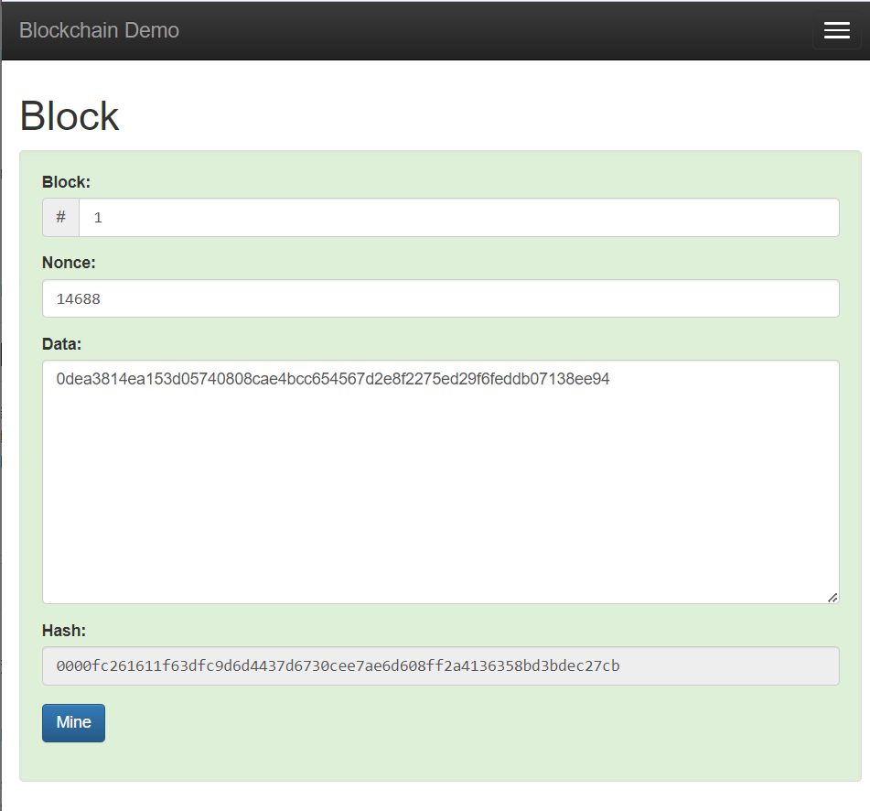

Slide 4
2.
6bdd3b8332f48a0954c6de66115c509c809e612d70912cd7c66cae38237b1893
1c7b34766aaa4c607e099255ca75279f5962cd123e4b7aa264081c85f10d5c36
f631921cddedcd302efd0e0584a379813da1dbf330386b4d03d7b4e846e2d3a5
d8e666f1bab18837e5ef4792d068b768f7dc0f1763664b0329fc1c6fb2a18110
2023
d398b29d3dbbb9bf201d4c7e1c19ff9d43c15fd45a0cec46fbe9885ec3f6e97f
C303
8bb41c0bbf34f878a92500d48ebb977e07f5b412102b5f70d74735ad3eb4c86b
資管系
a5a6aa8abc4417c78c542a4f1d3820f7f1e17330eac0045b2eff7bf647d0a7cb
許建隆
987b55b89ecae0aa6d0a9e16632830e9c6b745334ce0c5f67d4637731192f621
管理學院
599038bfdc914f23b6097e719b924fddc4ede97e87170384ac97b838b8e2debd

Slide 5
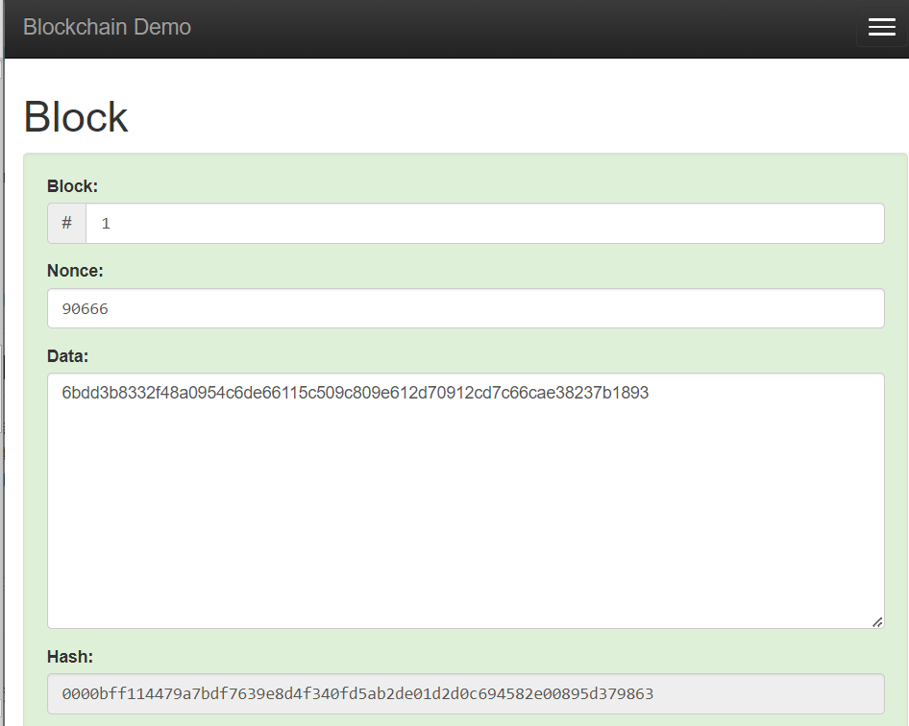

Slide 6
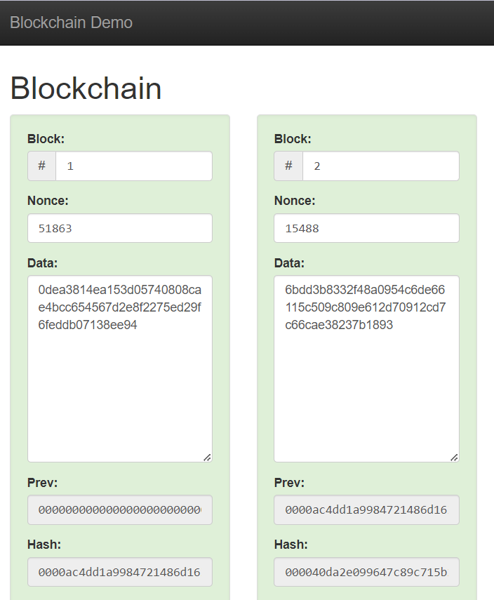

Slide 7
0fc4cc1e97908a54401c4e2b76e01a0a74781597ae48b5f4ca4e30a9ac06a481
區塊鏈
6f1732378fc14efb69a6e89dd59b1aa93a7c285ee43d4756432a455510c16311
blockchain
ef7797e13d3a75526946a3bcf00daec9fc9c9c4d51ddc7cc5df888f74dd434d1

Slide 8
